Slide 1
Passivity Based Energy Shaping Control for a Wheeled Quadruped
Hazim ALzorgan
Sriram Krishnamoorthy

Slide 2
Passivity
If a robot is not passive, its interaction with unknown environments can lead to instability
If a robot is passive, it is guaranteed to be stable
Leads to bounded and safe behavior
Most mechanical systems are passive
The energy of the system increases only if there is a net positive supply rate.
Storage function given by the Hamiltonian of the system.

Slide 3
Port Hamiltonian Systems (PHS)
Unified framework for physical modelling, geometrical analysis and control
Based on energy and power interaction between subsystems
Can be scaled to design and analyze large systems
Can be used to identify underlying physical structure of complex systems
Main idea: model a physical system based on interconnection of basic elements linked through energy ports.

Slide 4
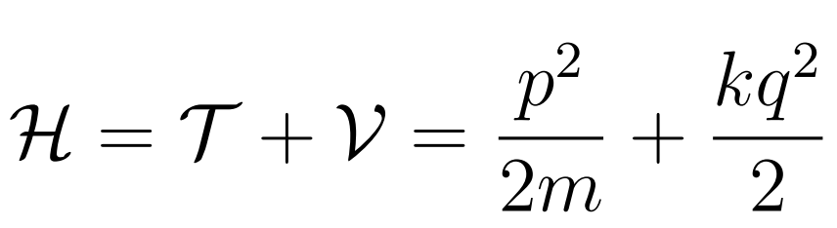
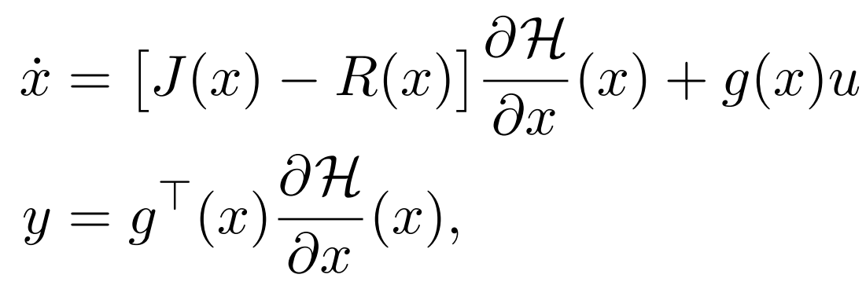
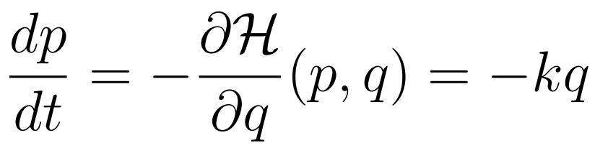
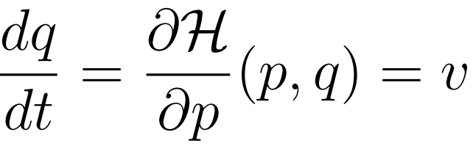
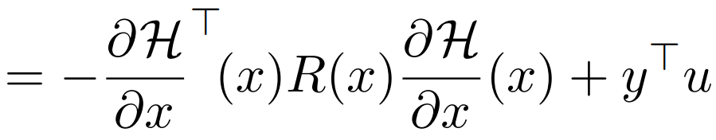
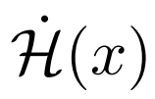
Basic elements

Slide 5
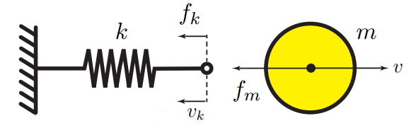

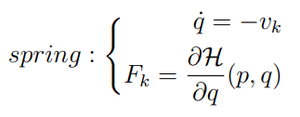
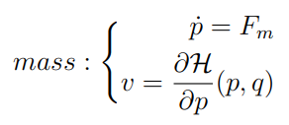
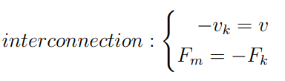
PHS of a Spring Mass System

Slide 6
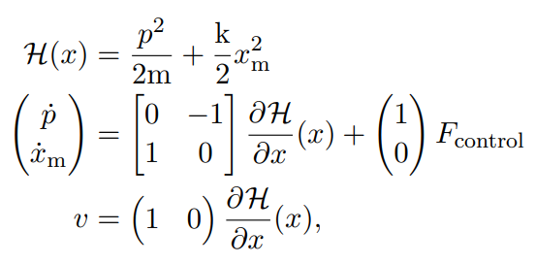


Passivity Based Energy Shaping Control

Slide 7
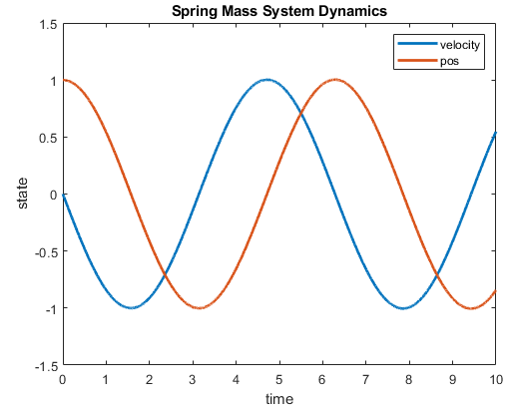
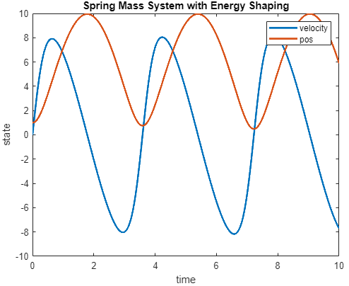
System Response

Slide 8
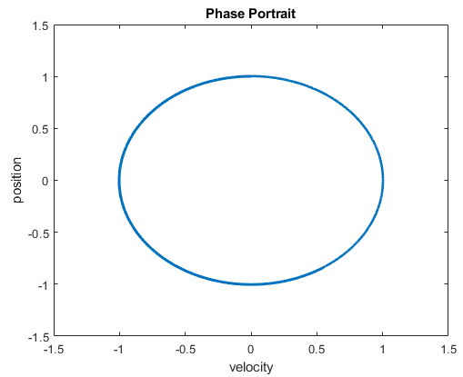
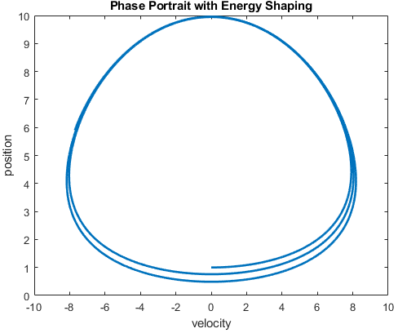
Phase Portrait

Slide 9
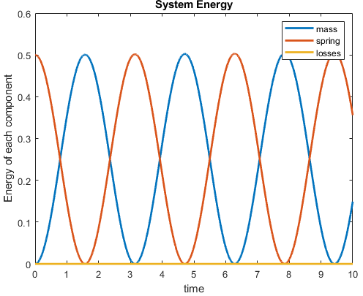
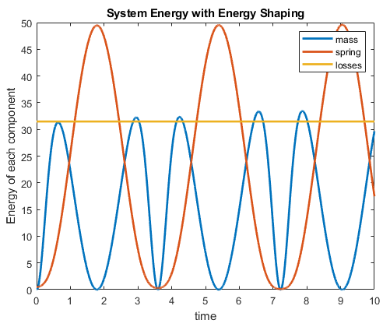
Energy Analysis

Slide 10
Thank You! Questions?

Slide 11
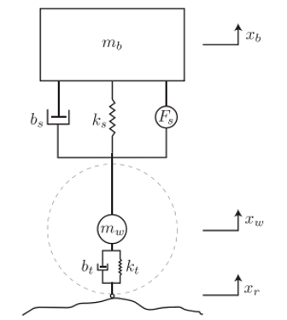
Quarter car model
Objectives:
Ride comfort: Minimize the sprung mass acceleration, by isolating vibration from the axle to the vehicle body.
Suspension travel: constrain the relative displacement between the axle and vehicle body for handling purposes.
Road holding: constrain tire deflection to provide adequate tire forces at the contact patch.

Slide 12
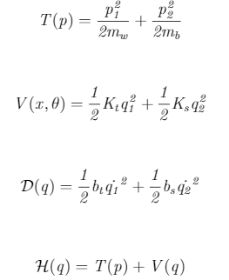
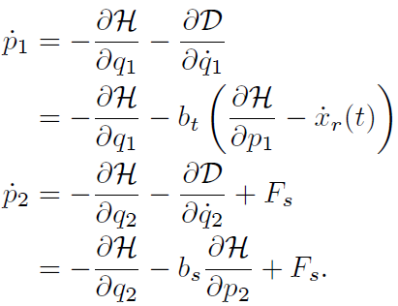
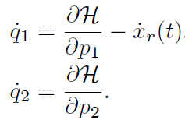
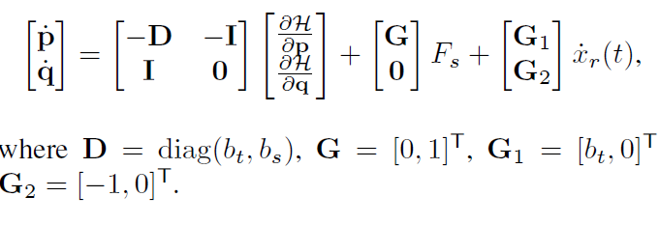
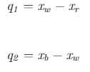
Quarter car model - PHS

Slide 13

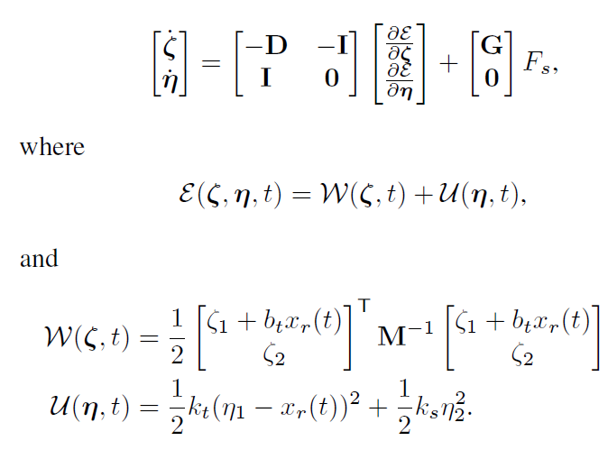
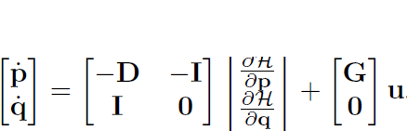

Quarter car model - PHS

Slide 14
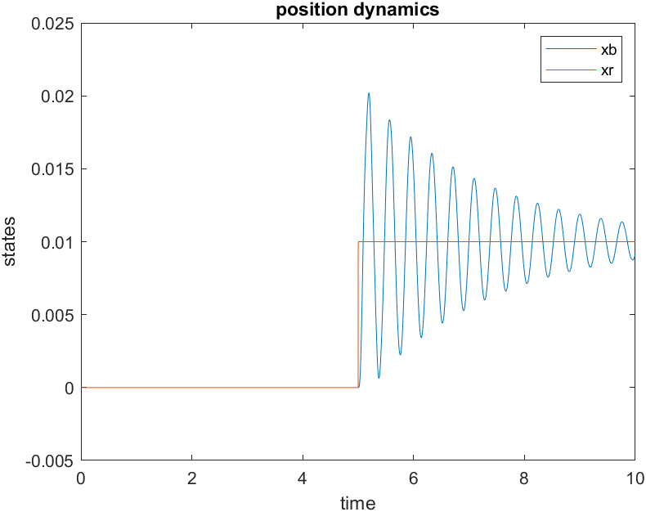
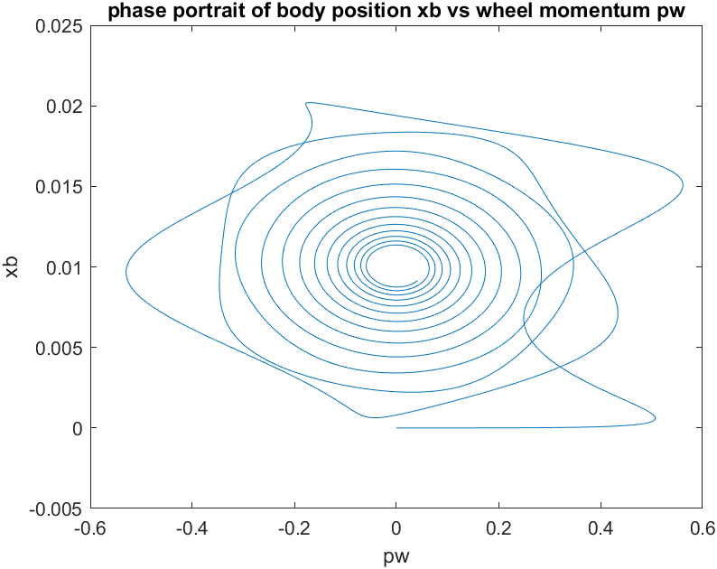
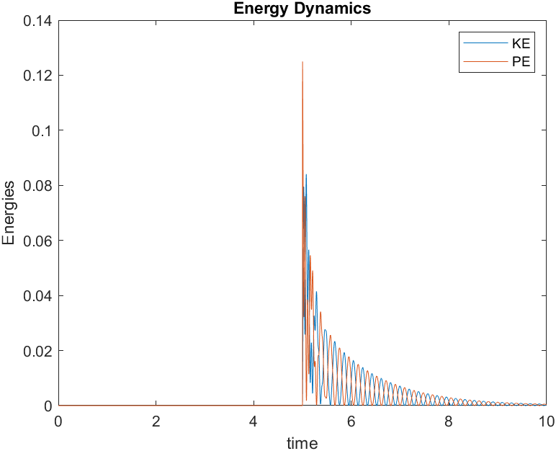
Simulation results – step input (no control)

Slide 15
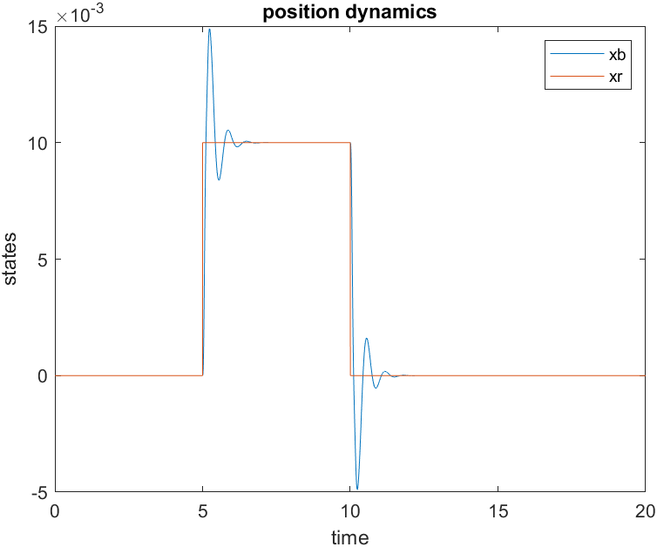
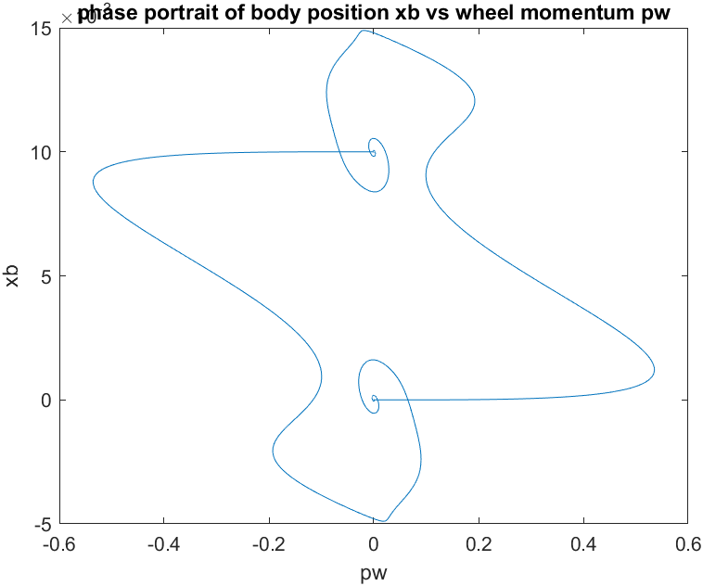
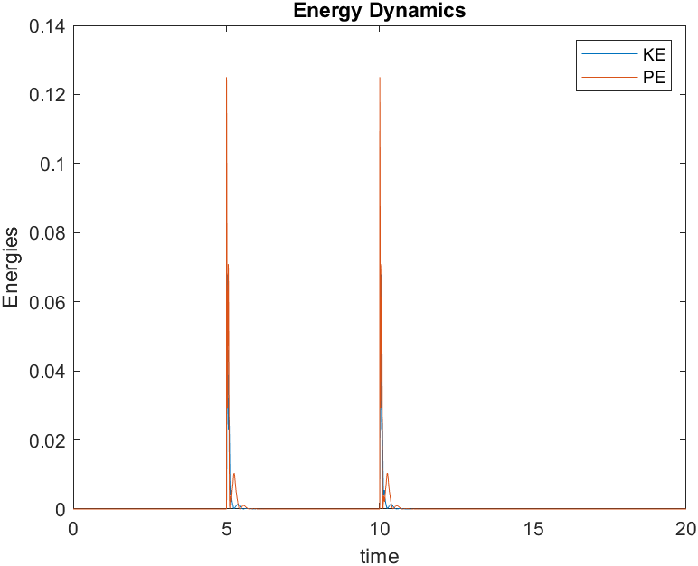
Simulation results – step input

Slide 16
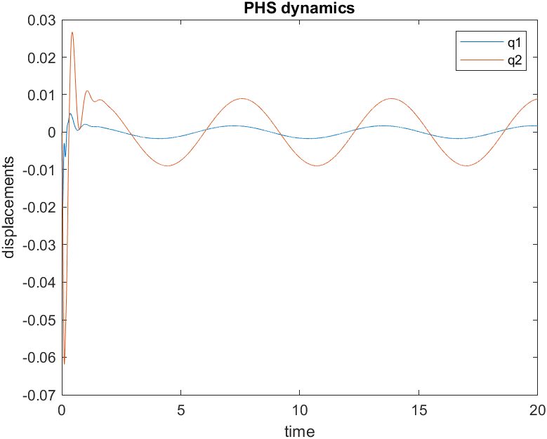
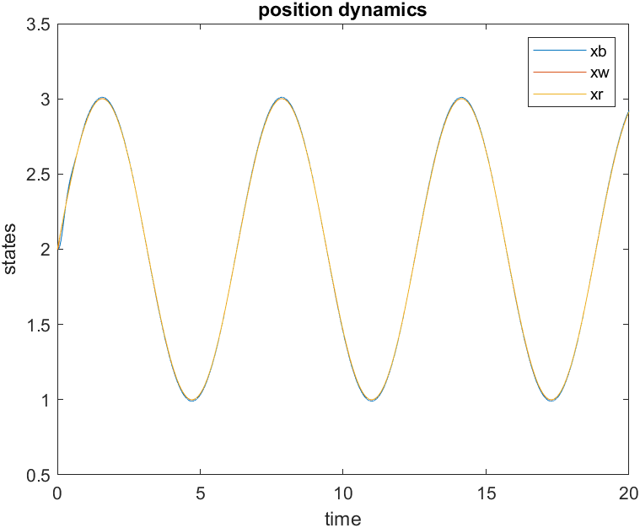
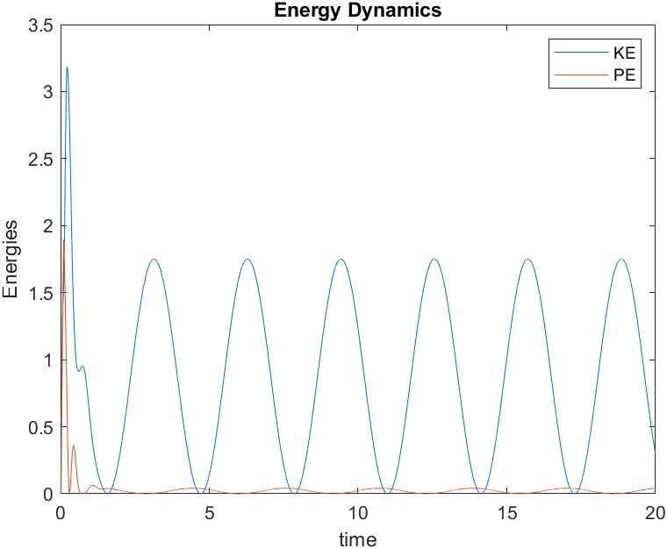
Simulation results – sine wave input

Slide 17
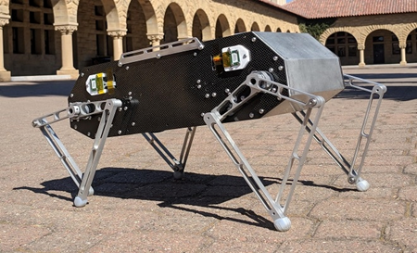
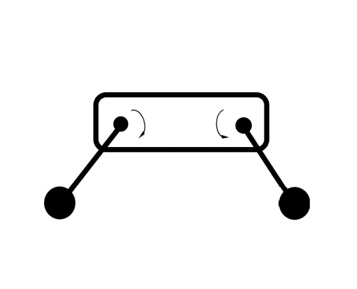
Wheeled quadruped
Agile four-legged robot with driven wheels and active suspension.
Conventional leg design replaced with a wheeled link.
Hip joint motor functions as suspension.
For offroad navigation applications.
Main goal is the constrain pitch and roll angles of the quadruped's body in a rough terrain environment.

Slide 18
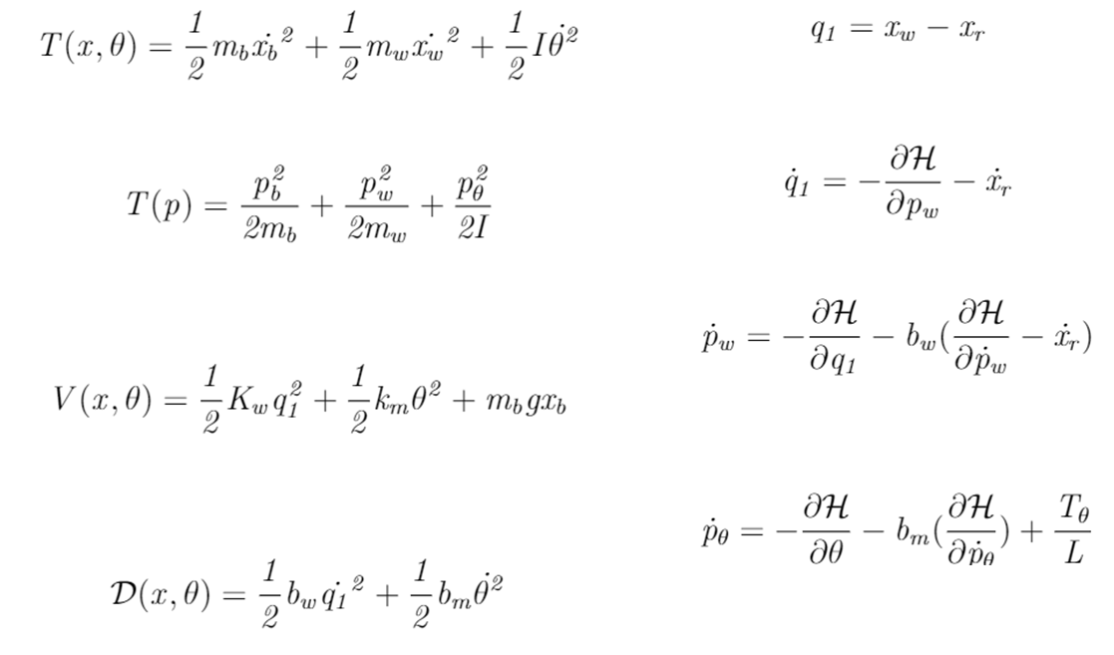
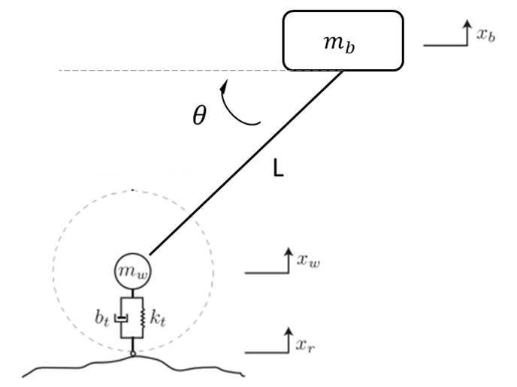
Quarter robot model

Slide 19
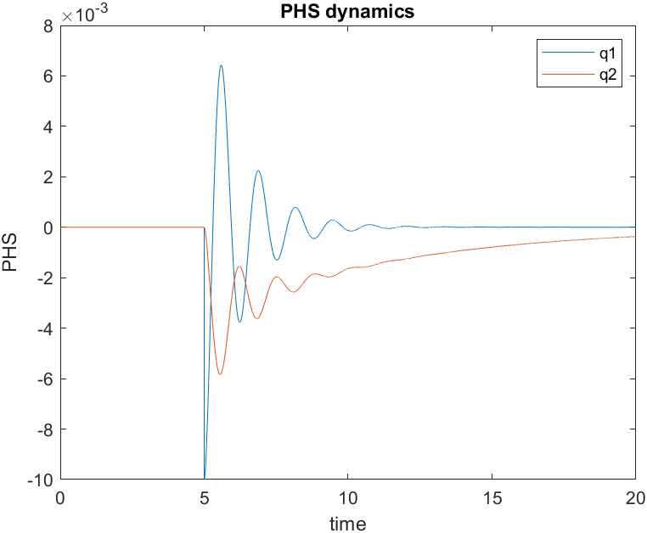
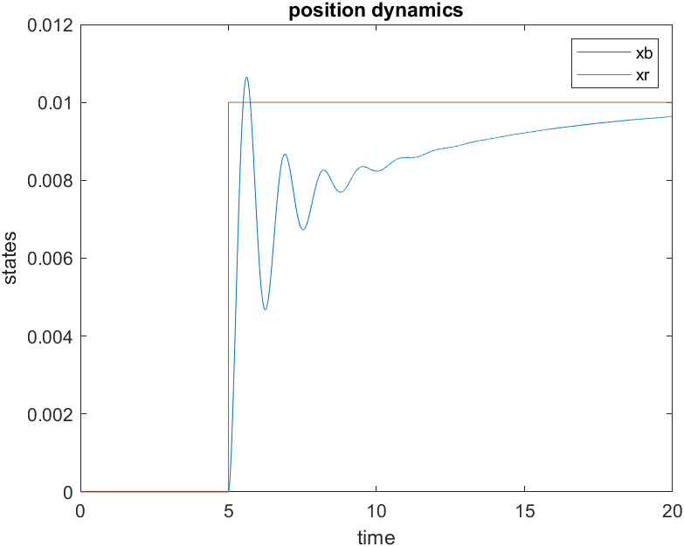
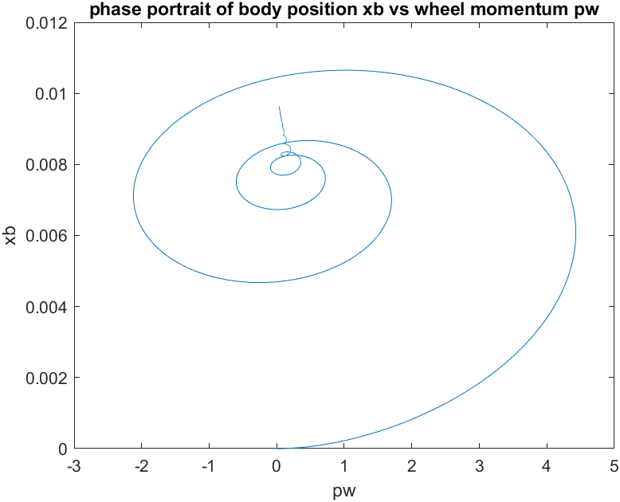
Simulation results_ step input

Slide 20
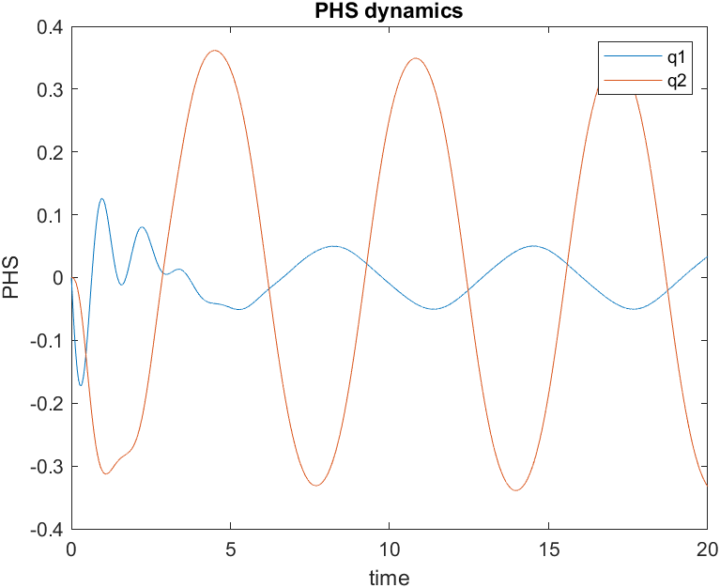
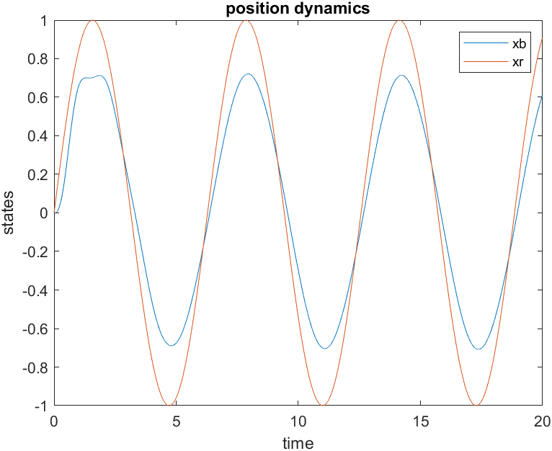
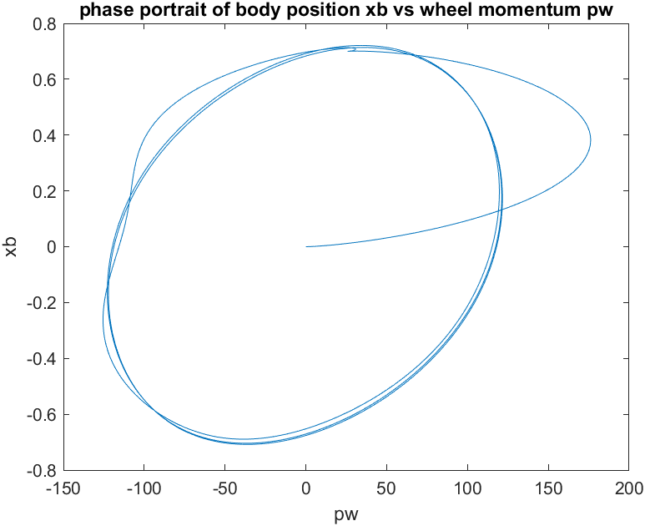
Simulation results_ sine input

Slide 21
Thank You! Questions?

